Slide 1
Non-Functional Requirements
aka
“The –ilities”
REMINDER: all this is fair game for exams!
Stephen Riley, MSE ‘07

Slide 2

Housekeeping
Mid-term exam next Tuesday, Feb. 11
In-class
Closed book
Bring paper and writing utensils
If you have questions, ask MJ

Slide 3
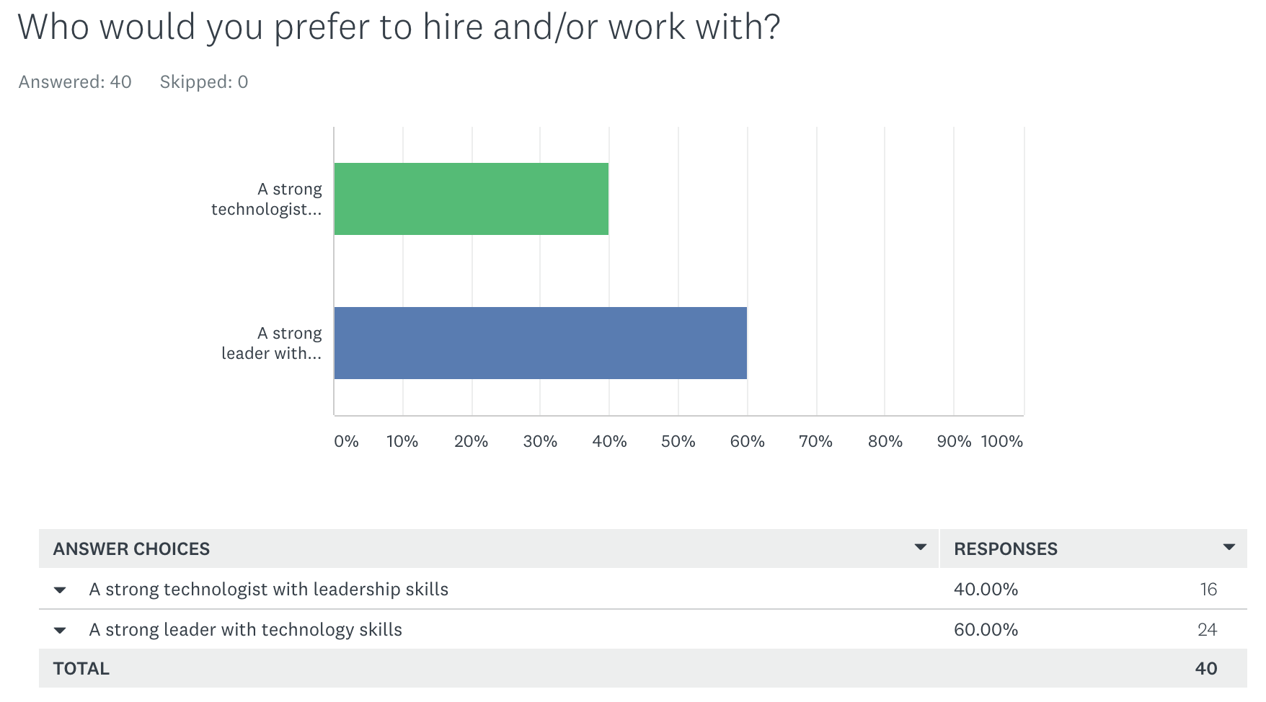
…an aside on tech leadership…

Slide 4
Agenda
Definitions
A non-comprehensive list
Deep dive
Case study
Q&A

Slide 5
Before we get started…
Survey: what caused the problems in the Iowa Caucus?

Slide 6
Definitions

Slide 7
Requirements
A requirement is a testable assertion of the customer’s need

Slide 8
Functional vs Non-functional Reqs
Functional requirements define what the system should do

Slide 9
Functional vs Non-functional Reqs
Non-functional requirements define how the system should behave

Slide 10
Functional vs Non-functional Reqs
Non-functional requirements define criteria to judge the operation of a system

Slide 11
Functional vs Non-functional Reqs
Non-functional requirements define the quality of the system

Slide 12
Functional vs Non-functional Reqs
Non-functional requirements define the -ilities

Slide 13
Why do we care?
Quality
Edwards Demming’s rubric of quality: Does it satisfy the customer’s requirements?
Other –ilities: responsibility and liability
Bottom line: NFRs will kill an otherwise good product!

Slide 14
A non-comprehensive list

Slide 15
A non-comprehensive list
Accessibility
Adaptability
Auditability and control
Availability (see service level agreement)
Backup
Capacity, current and forecast
Certification
Compliance
Configuration management
Cost, initial and Life-cycle cost
Data integrity
Data retention
Dependency on other parties
Deployment
Development environment
Disaster recovery
Documentation
Durability
Efficiency (resource consumption for given load)
Effectiveness (resulting performance in relation to effort)
Emotional factors (like fun or absorbing or has "Wow! Factor")
Environmental protection
Escrow
Exploitability
Extensibility (adding features, and carry-forward of customizations at next major version upgrade)
Failure management
Fault tolerance (e.g. Operational System Monitoring, Measuring, and Management)
Integrability ability to integrate components
Internationalization and localization
Interoperability
Legal and licensing issues or patent-infringement-avoidability
Maintainability (e.g. Mean Time To Repair - MTTR)
Management
Modifiability
Network topology
Open source
Operability
Performance / response time (performance engineering)
Platform compatibility
Privacy (compliance to privacy laws)
Portability
Quality (e.g. faults discovered, faults delivered, fault removal efficacy)
Readability
Reliability (e.g. Mean Time Between/To Failures - MTBF/MTTF )
Reporting
Resilience
Resource constraints (processor speed, memory, disk space, network bandwidth, etc.)
Response time
Reusability
Robustness
Safety or Factor of safety
Scalability (horizontal, vertical)
Security (cyber and physical)
Software, tools, standards etc. Compatibility
Stability
Supportability
Testability
Throughput
Transparency
Usability (Human Factors) by target user community
Volume
Yes, these all matter!

Slide 16
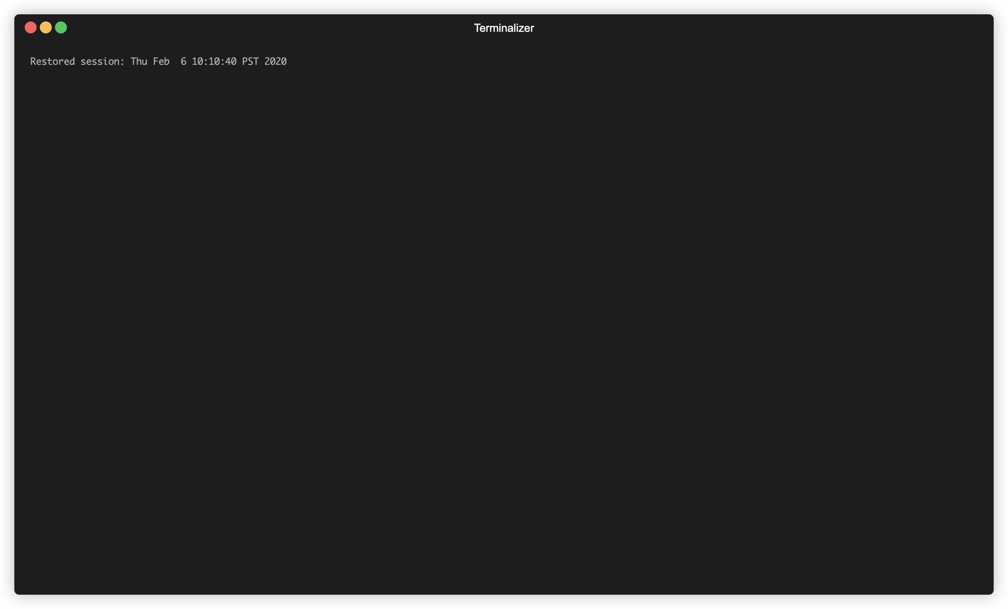
A comprehensive list
😂

Slide 17
Deep dive

Slide 18
NFRs we’ll talk about
Accessibility
Adaptability
Auditability and control
Availability
Capacity, current and forecast
Compliance
Development environment
Durability
Exploitability
Internationalization and localization
Maintainability
Operability
Performance / response time
Quality
Reliability
Resilience
Resource constraints
Scalability
Testability
Usability (Human Factors)

Slide 19
The big ones

Slide 20
Availability / SLA
Service Level Agreement
Ratio of total time a functional unit/system is capable of being used to the length of the time interval
Typically referred to in “9s”
Eg. 4-9s is 99.99%
Who: For commercial SaaS products, this is #1

Slide 21
Capacity
How many customers/operations can your system handle?
How much data can your system store?
“Hope for the best, plan for the worst”
Use patterns, tech that handles growth well (but you will pay for it! Eg. Apache Cassandra)
Who: Cloud systems, high volume data systems, audited systems

Slide 22
Durability
When data is stored, will it survive?
Key to ACID databases (keyword: “two-phase commit”)
S3 durability rating: 99.999999999% (11-9s)
Who: DBs, storage

Slide 23
Operability
How easy/hard is it to run the system?
DON’T BE LAZY.
DevOps vs. “throw it over the wall”
Who: single tenant systems, microservice architectures

Slide 24
Performance / Response time
How fast does your system respond?
How consistently does your system respond?
Look at percentiles
Who: SaaS, e-commerce
https://github.com/mspnp/performance-optimization/blob/master/Performance-Analysis-Primer.md

Slide 25
Reliability
Defined as 1 – probability of failure
Mean Time Between Failure (MTBF)
Related to Availability
1-availability is the average of failure
Reliability is the period of failure

Slide 26
Scalability
Can your system grow?
Horizontal vs vertical scalability
Plan for this up front—“adding” scalability later is “difficult” ☺
Hint: ask your CFO/CEO/CRO what planned YoY growth is

Slide 27
Testability
You can’t fix what you can’t measure
You can’t deliver what you can’t measure
QA testers are a source of requirements!
Who: EVERYONE

Slide 28
Other important ones

Slide 29
Accessibility
Visual impairment, hearing impairment, reading disorders
Decide up front what your target is
Eg. “Revised 508 Standards”
Government, NGOs, non-profits

Slide 30
Adaptability / Extensibility
Ability to change
“Overfitting” the architecture
Helpful strategies:
Data-driven architectures
DSLs or embedded scripting languages
Can increase cognitive load!

Slide 31
Auditability / Compliance
Eg. HIPAA, SOC-2, PCI
Failure here will kill your company
Make your systems, data easy to audit (otherwise audits will kill your efficiency and morale!)
Who: Government, medical, legal, e-commerce

Slide 32
COGS
Cost of Goods Sold
If you make $100/user, don’t spend $150 on resources!
For SaaS, try to isolate the cost of hosting/serving a user
If not user, try customer
If not customer, how do you know you’re doing a good job?!
Who: cloud-based systems, B2C, SaaS

Slide 33
Development environment
Poor dev/engineering experience leads to turnover
…but don’t get caught by the New Hotness™
Eg. TNG tech choice
Who: anyone operating in a competitive hiring market

Slide 34
Exploitability / Security
Related to Auditability and Compliance
Open Web Application Security Project (OWASP) is a good starting point
If you can, pay for security reviews, audits, pen-tests, etc.
Who: fin-tech, government, medical, anyone dealing with PII

Slide 35
Internationalization (I18N, L10N)
I18N: the ability of the system to be localized
L10N: the actual translation of a system to a specific locale
Start early—“adding” I18N later is “difficult” ☺
Who: anyone even thinking of going global

Slide 36
Maintainability
How easy is it to fix problems?
Mean Time To Repair (MTTR)
This number always goes up over time, but you can control the exponent
Who: everyone

Slide 37
Quality (metrics)
No hard and fast rules here…
Eg. Bugs open, bugs closed, relative trends, volume over time…
Good sniff test
BUT: good requirements are the best cure

Slide 38
Resilience
The ability to provide and maintain an acceptable level of service in the face of faults and challenges to normal operations
PLAN FOR FAILURE.
Retries
Circuit-breaker
Compensating transactions (CQRS)
Queue-based load balancing
Who: any distributed system (spoiler: they’re all distributed)

Slide 39
Resource constraints
Related to Capacity.
In the cloud world, this directly translates to $$$ in real time
(Which is awesome, you’re so lucky to be alive now, get off my lawn… ☺)
Key numbers: network bandwidth, storage size and bandwidth, number of cores
Who: everyone

Slide 40
Usability
aka Human Factors, Human Usability, UX
How easy is it to use the system?
Hard to measure precisely, easy (but expensive) to do empirically
Who: consumer products (enterprise doesn’t care ☺)

Slide 41
Case study
“IowaReporter” by Shadow, Inc.

Slide 42
What’s known
Built to 2 month deadline
“Security through obscurity” (ask the MPAA how that works)
Deployed by downloading an APK
Very little training
Very little documentation
Insufficient phone lines for alternate reporting method
Not stress, load tested
Built by a company called “Shadow”

Slide 43
Questions on NFRs (or Eng’g Econ)?

Slide 44
Advice from a gray-hair

Slide 45
My advice
Practice coding. codesignal.com
ABC: Always Be Coding.
Read, always. reddit.com/r/programming
Build a library. (Manning Press has great sales)
Find mentors.
Network. (LinkedIn is your professional social media platform)
It gets easier! ☺

Slide 46


